Slide 1


Vertigo Mythbusters
A Straightforward Approach To Vertigo
Matthew McArthur CCFP(EM)

Slide 2
Learning Objectives
adopt a simple, safe, and effective approach to vertigo
recognize red flag clinical features that are worrisome for a dangerous central cause of acute dizziness/vertigo
confidently diagnose the two common types of BPPV (posterior and horizontal canal), using history and physical exam maneuvers (Dix Hallpike and Supine Roll Test)
treat posterior canal BPPV using the Epley maneuver
understand how the HINTS+ exam can help establish a diagnosis of vestibular neuritis in a patient with the acute vestibular syndrome

Slide 3
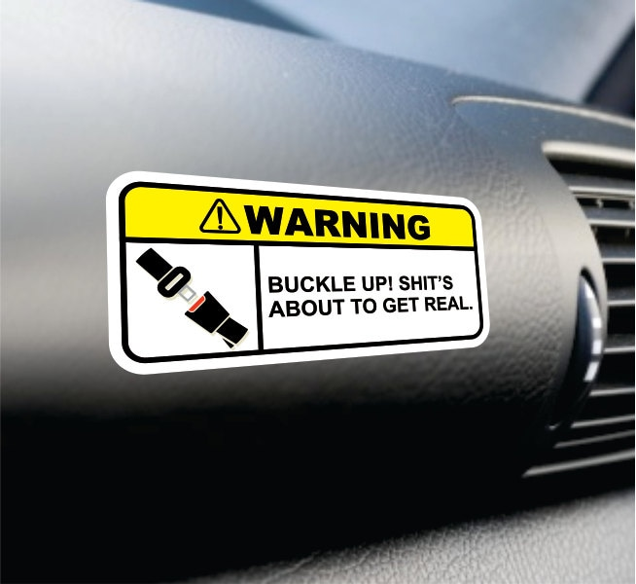
Learning Objectives
adopt a simple, safe, and effective approach to the evaluation and management of vertigo
debunk common clinical myths about vertigo
recognize red flag clinical features that are worrisome for a dangerous central cause of acute dizziness/vertigo
confidently diagnose the two common types of BPPV (posterior and horizontal canal), using history and physical exam maneuvers (Dix Hallpike and Supine Roll Test)
treat posterior canal BPPV using the Epley maneuver
understand how the HINTS+ exam can help establish a diagnosis of vestibular neuritis in a patient with the acute vestibular syndrome

Slide 4

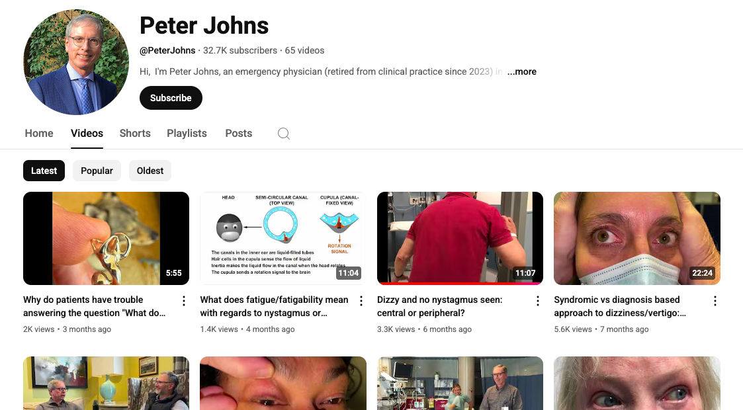
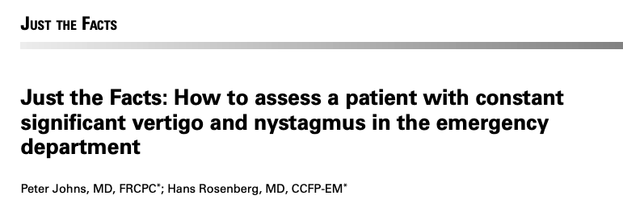
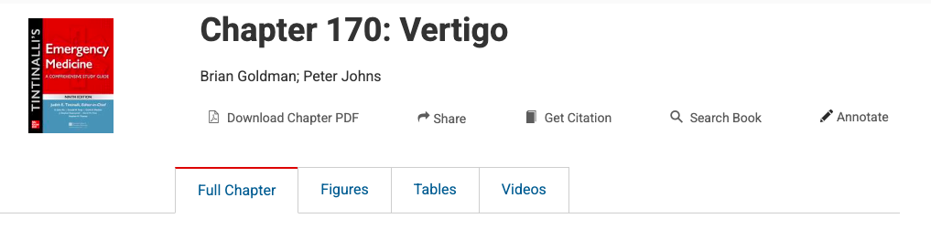
Shout Out to Dr Johns

Slide 5
Why Is Vertigo So Tricky
Can be caused by many diagnoses from benign to serious
Patients have a hard time describing what they are feeling
Poorly taught in medical education

Slide 6
ED Docs Struggle With Vertigo
Retrospective Chart Review of 2309 dizzy patients (2021, Dmitriew et al, Sudbury)
  19.5% of dizzy patients received the HINTS exam
  96.9% of those who received the HINTS exam, it was NOT indicated
  53% of patients who had indications for DHT, received DHT
  29% of patients who received DHT, had clear contraindications for DHT
Retrospective Chart Review of 175 dizzy patients (2025, Nolan et al, Miami)
  71% of HINTS exam were performed on inappropriate patients
Dmitriew C et al. Acad Emerg Med. 2021 Apr;28(4):387-393
Dmitriew C et al. CJEM. 2021 Sep;23(5):613-616
Nolan K et al. Am J Emerg Med. 2025 Aug;94:185-187

Slide 7
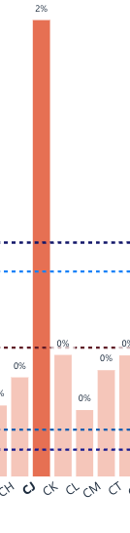

Slide 8
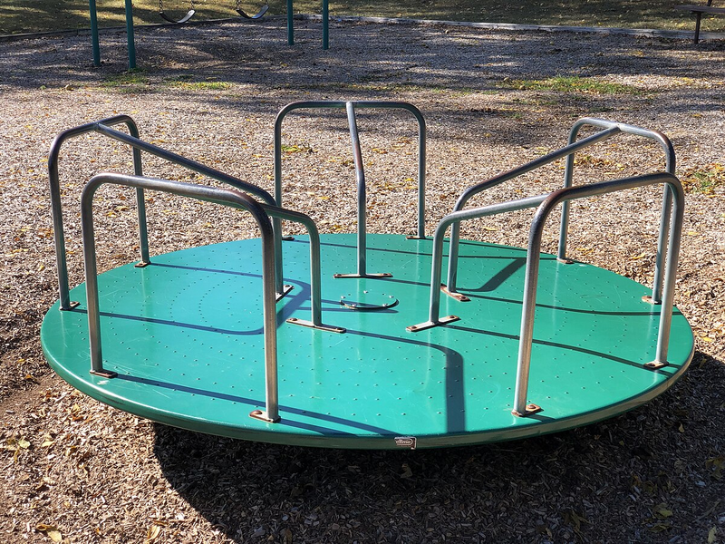
Definitions
Vertigo - illusory sensation of movement even when still
Dizziness - non-specific term for being off balance, woozy, etc
Nystagmus – repetitive, involuntary eye movements

Slide 9
Differential for Acute Dizziness
Presyncope
  Orthostatic, vasovagal, cardiac, etc…
Central Causes of Dizziness
  Cerebrovascular accident (stroke/TIA/ICH)
  Multiple sclerosis
  CNS tumour
  Drug intoxication or side effect
  Post Concussion Syndrome
  Vestibular migraine
Peripheral Causes of Dizziness
  BPPV
  Vestibular neuritis
  Meniere’s Disease
  Superior Canal Dehiscence Syndrome
  Acoustic Shwannoma
“Weak and Dizzy” aka general medical cause
  DDx = literally anything

Slide 10
Differential for Acute Dizziness
Presyncope
  Orthostatic, vasovagal, cardiac, etc…
Central Causes of Dizziness
  Cerebrovascular accident (stroke/TIA/ICH)
  Multiple sclerosis
  CNS tumour
  Drug intoxication or side effect
  Post Concussion Syndrome
  Vestibular migraine
Peripheral Causes of Dizziness
  BPPV
  Vestibular neuritis
  Meniere’s Disease
  Superior Canal Dehiscence Syndrome
  Acoustic Shwannoma
“Weak and Dizzy” aka general medical cause
  DDx = literally anything

Slide 11
Differential for Acute Dizziness
Presyncope
  Orthostatic, vasovagal, cardiac, etc…
Central Causes of Dizziness
  Cerebrovascular accident (stroke/TIA/ICH)
  Multiple sclerosis
  CNS tumour
  Drug intoxication or side effect
  Post Concussion Syndrome
  Vestibular migraine
Peripheral Causes of Dizziness
  BPPV
  Vestibular neuritis
  Meniere’s Disease
  Superior Canal Dehiscence Syndrome
  Acoustic Shwannoma
“Weak and Dizzy” aka general medical cause
  DDx = literally anything

Slide 12
Differential for Acute Dizziness
Presyncope
  Orthostatic, vasovagal, cardiac, etc…
Central Causes of Dizziness
  Cerebrovascular accident (stroke/TIA/ICH)
  Multiple sclerosis
  CNS tumour
  Drug intoxication or side effect
  Post Concussion Syndrome
  Vestibular migraine
Peripheral Causes of Dizziness
  BPPV
  Vestibular neuritis
  Meniere’s Disease
  Superior Canal Dehiscence Syndrome
  Acoustic Shwannoma
“Weak and Dizzy” aka general medical cause
  DDx = literally anything

Slide 13
Differential for Acute Dizziness
Presyncope
  Orthostatic, vasovagal, cardiac, etc…
Central Causes of Dizziness
  Cerebrovascular accident (stroke/TIA/ICH)
  Multiple sclerosis
  CNS tumour
  Drug intoxication or side effect
  Post Concussion Syndrome
  Vestibular migraine
Peripheral Causes of Dizziness
  BPPV
  Vestibular neuritis
  Meniere’s Disease
  Superior Canal Dehiscence Syndrome
  Acoustic Shwannoma
“Weak and Dizzy” aka general medical cause
  DDx = literally anything

Slide 14
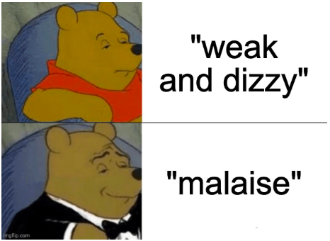
Differential for Acute Dizziness
Presyncope
  Orthostatic, vasovagal, cardiac, etc…
Central Causes of Dizziness
  Cerebrovascular accident (stroke/TIA/ICH)
  Multiple sclerosis
  CNS tumour
  Drug intoxication or side effect
  Post Concussion Syndrome
  Vestibular migraine
Peripheral Causes of Dizziness
  BPPV
  Vestibular neuritis
  Meniere’s Disease
  Superior Canal Dehiscence Syndrome
  Acoustic Shwannoma
“Weak and Dizzy” aka general medical cause
  DDx = literally anything

Slide 15
Differential for Acute Dizziness
Presyncope
  Orthostatic, vasovagal, cardiac, etc…
Central Causes of Dizziness
  Cerebrovascular accident (stroke/TIA/ICH)
  Multiple sclerosis
  CNS tumour
  Drug intoxication or side effect
  Post Concussion Syndrome
  Vestibular migraine
Peripheral Causes of Dizziness
  BPPV
  Vestibular neuritis
  Meniere’s Disease
  Superior Canal Dehiscence Syndrome
  Acoustic Shwannoma
“Weak and Dizzy” aka general medical cause
  DDx = literally anything
5) Metabolic: eg hypoglycemia, hyponatremia…

Slide 16
Simplified “Big 3” Approach for Acute Dizziness
1) BPPV – common, you can accurately diagnose on H+P
2) Vestibular Neuritis – common, you can accurately diagnose on H+P
3) Dizzy Stroke/CVA – uncommon but serious, you don’t want to miss it
Notes:
You don’t want to send home a patient with chest pain who is having an MI, you don’t want to send home a patient with dizziness who is having an infarction of the brain == in ED we need to know how to recognize the serious acute presentation

Slide 17
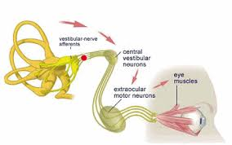
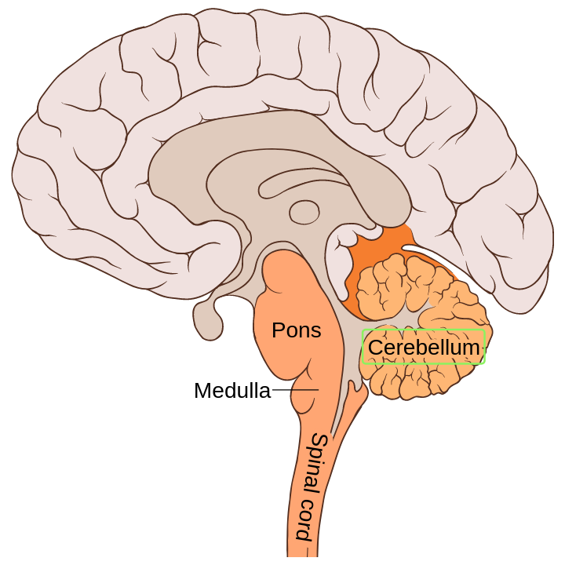
Key Anatomy/Physiology Concepts
1
Vestibular Apparatus
  Senses Movements of the Head
Vestibular Nerve
  Relays information from VA
Vestibulo-Ocular Reflex
  extra-ocular muscles receive continuous input from vestibular apparatus (auto-stabilize)
Cerebellum
  Controls balance and coordination
2
3
4

Slide 18
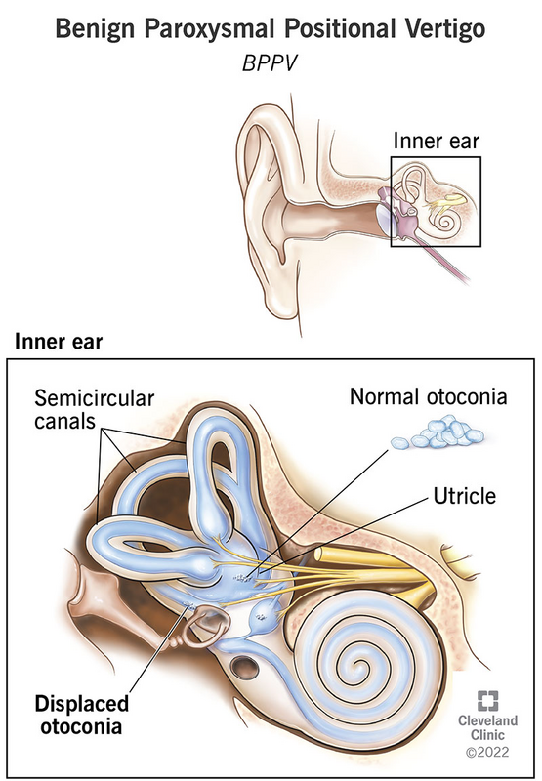
1. BPPV
Most common cause peripheral vertigo
Median age ~52
Caused by loose debris (otoconia) within the semicircular canals
Intermittent intense, short-lived vertigo episodes initiated by head movements
Eventually resolves after otoliths return to utricle
  Takes average of ~2-6 weeks to resolve without treatment
  Appropriate particle repositioning maneuvers should result in immediate cure
Notes:
https://my.clevelandclinic.org/health/diseases/11858-benign-paroxysmal-positional-vertigo-bppv

Slide 19
Key Word: Paroxysmal
Typical presentation for BPPV is someone who gets sudden intense dizzy spells lasting <1min that are triggered by lying down or turning over in bed and resolve when still
CAVEATS:
***patients are often nauseous and feel generally unwell for minutes/hours after attack***
***patients sometimes feel a milder “residual dizziness” between attacks***

Slide 20


Slide 21
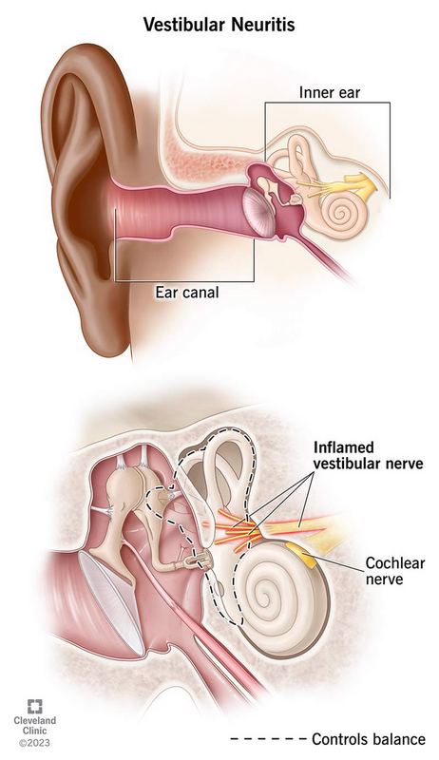
2. Vestibular Neuritis
Acute unilateral vestibular nerve dysfunction
  Thought to be postviral/inflammatory
Most common in ages 30-50
Causes acute onset of continuous vertigo, nystagmus, imbalance, nausea, vomiting lasting hours to days (Acute Vestibular Syndrome)
Dizziness is continuous, even when patient is completely still, but worse with head movements
Self-limited, dizziness is usually worst on day 1-2 and resolves gradually over days-weeks
Causes unidirectional, horizontal nystagmus*
Notes:
Image https://my.clevelandclinic.org/health/diseases/15227-vestibular-neuritis
Causes unidirectional horizontal nystagmus which beats away from the affected ear, is more pronounced with gaze in the direction of the nystagmus
Causes an impaired vestibular ocular reflex which can be tested with the head impulse test

Slide 22
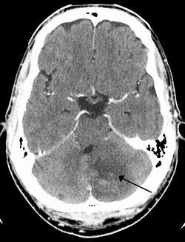
3. Dizzy Stroke
Infarction of cerebellum / posterior circulation
~2-5% of all Dizzy ED patients
Sudden onset continuous dizziness and/or imbalance
  NB: Acute Vestibular Syndrome = dizziness, nystagmus, N/V, imbalance x hours-days
Often + other neurological features
Significant Ataxia / Inability to walk is worrisome for stroke
Nystagmus may or may not be present
Significant morbidity and mortality
Not well seen on CT

Slide 23
Approach to Evaluating Acute Dizziness

Slide 24

Step 1 - Screen For Central Features!!
New significant headache or neck pain
Focal Neurologic Symptoms
5 Dangerous D’s (Dysarthria, Diplopia, Dysphagia, Dysmetria, Dysphonia)
Vertical Nystagmus at Rest
New significant ataxia / inability to walk
All of these patients need workup for stroke/central causes
Notes:
THESE SHOULD NOT USUALLY BE PRESENT IN ANY OF THE BENIGN CAUSES OF VERTIGO
Headache/neck pain – consider bleed or vertebral artery dissection, CT/CTA head/neck)

Slide 25
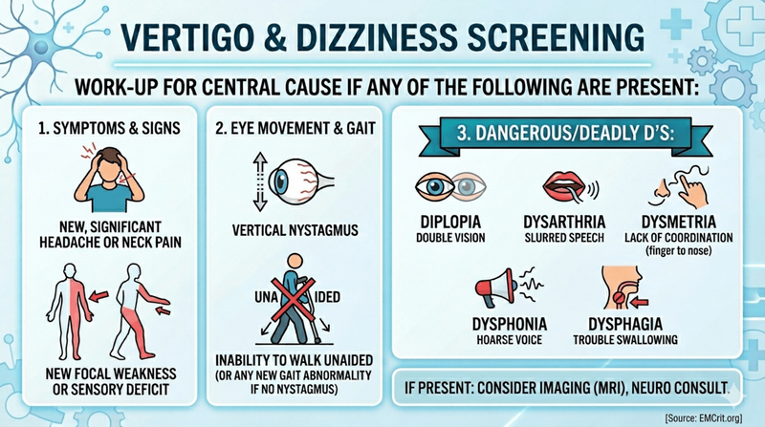

Slide 26
Myth: Asking A Patient “What Do You Mean By Dizzy” is a Reliable Way to Determine Cause
4 subjective sensations of dizziness:
  vertigo (vestibular problem)
  presyncope (cardiac problem)
  disequilibrium (cerebellar problem)
  nonspecific dizziness (psychiatric or metabolic)
But is it really that simple???
Newman-Toker et al 2007, Kerber 2015

Slide 27
Patients suck at describing dizziness
2007 Study of ~300 ED patients who complained of dizziness
  62% selected more than one type of dizziness
  Asked to select from a list; 54% did not pick a symptom they previously endorsed in open ended description
  70% who initially did not identify spinning; did say spinning with direct questioning
  52% changed their response when re-surveyed 5-10min later
Newman-Toker et al 2007, Kerber 2015

Slide 28
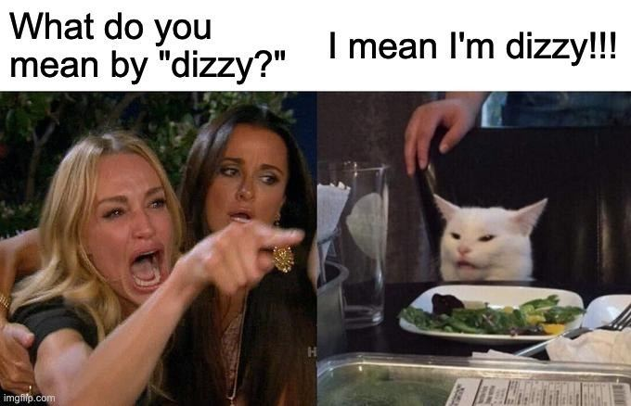

Slide 29

Myth Busted:
Subjective description of dizziness unreliable and inconsistent
Conversely- other parts of the history including: onset, trigger, duration, intensity, associated symptoms ARE reliable
Patient’s subjective description of dizziness cannot definitely rule in or out any cause
Newman-Toker et al 2007, Kerber 2015

Slide 30
MOST IMPORTANT QUESTION FOR DIZZINESS
“What do you mean by dizzy?”
“What were you doing when the dizziness started?”

Slide 31
History Pearl
2018 Study of 149 Patients Seen at an ENT Dizziness Clinic in Sweden
59/149 were diagnosed with BPPV
“Dizziness when laying down or turning in bed”
Odds Ratio for BPPV = 60
“Continuous dizziness duration (as opposed to lasting seconds)”
Odds Ratio for BPPV = 0.06
Lindell et al 2018

Slide 32
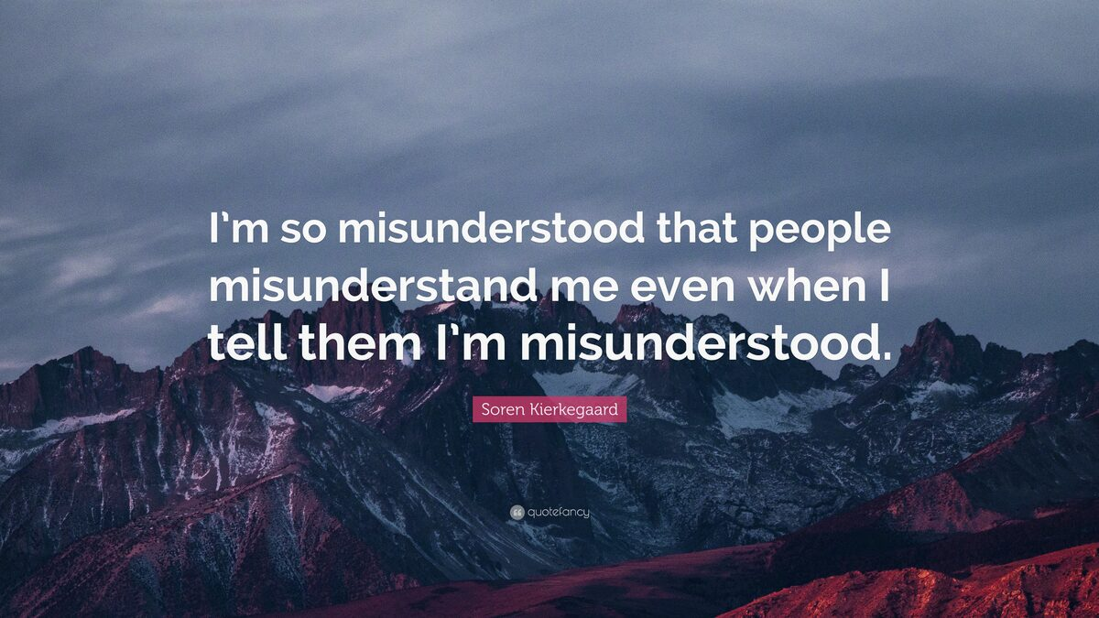
Let’s Talk About Clinical Vertigo Maneuvers

Slide 33
Dix Hallpike Knowledge Question
You are seeing a patient who reports 30-second attacks of intense dizziness triggered by turning over in bed that subside when lying still. Right ear Dix Hallpike is unremarkable. You perform a Left Ear Dix Hallpike and see subtle horizontal, left beating nystagmus lasting 10 seconds and the patient feels a little dizzy. What is your next best step?
a) Proceed with Left Ear Epley to treat left ear BPPV
b) Perform a Supine Roll Test
c) Proceed with Right Ear Epley
d) Perform the Gufoni Maneuver

Slide 34
BPPV, not a single diagnosis
There are 2 ears
Each ear has 3 semicircular canals
Different provocative tests are designed to move otoconia in different canals
Otoconia produce different types of nystagmus depending on which canal they are in
===> Therefore, we can localize which ear and canal the stones are in using provocative testing, by watching to see if the correct nystagmus occurs

Slide 35
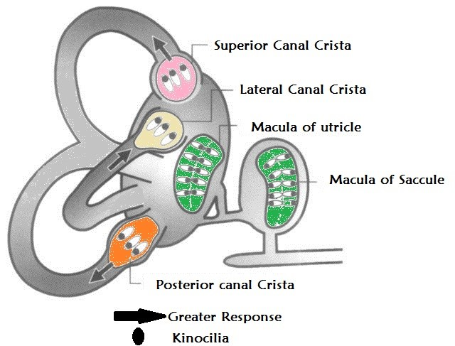
Posterior Canal BPPV
Most common BPPV subtype
= ~60-65% of all BPPV
Otoconia are in posterior canal
Dix Hallpike is the provocative test for these patients
Provocative Testing Produces Torsional Nystagmus

Slide 36
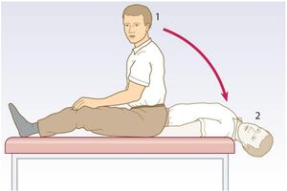
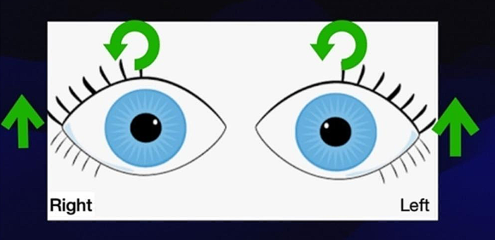
Dix Hallpike
Dix Hallpike on the affected side is positive ONLY if you see ~5-40 seconds of nystagmus with an upward and torsional component
Nystagmus seen in R ear BPPV

Slide 37
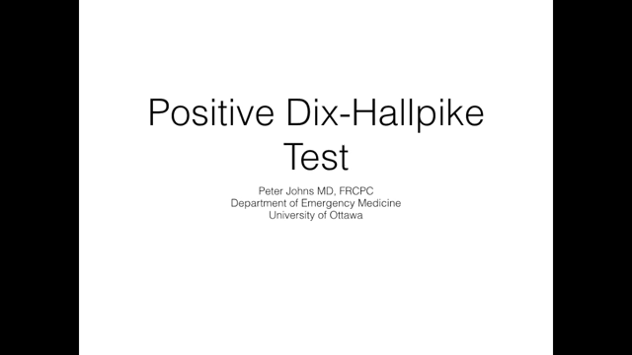

Slide 38
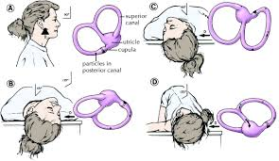
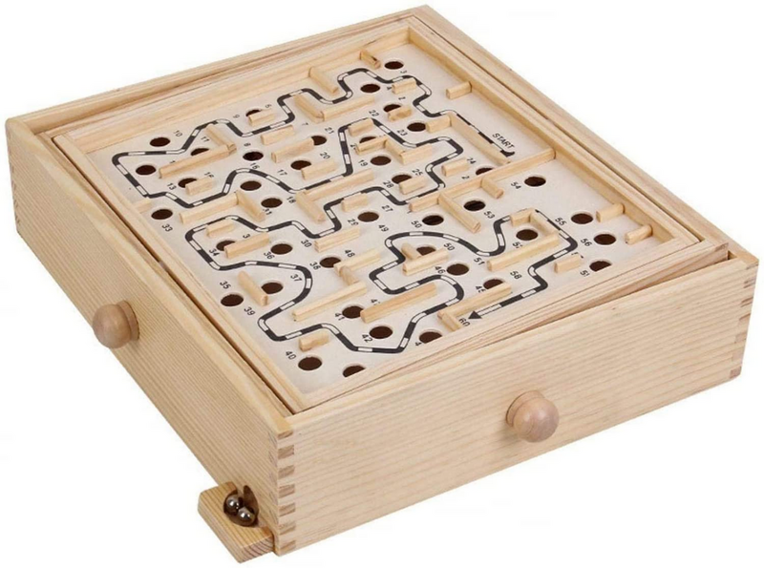
Epley Manuever to Cure Posterior Canal BPPV

Slide 39
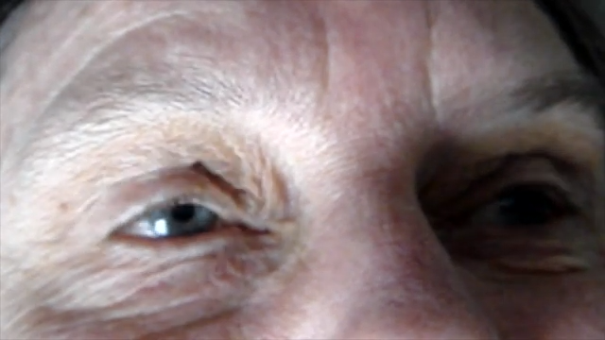

Slide 40
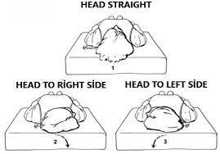
Horizontal Canal BPPV
~30% of BPPV
Supine Roll Test
SRT produces horizontal nystagmus which either beats towards the ground or away from the ground (geotropic or apogeotropic)
Gufoni Maneuver is the curative maneuver
HUGE Pearl - if you do a Dix Hallpike but see horizontal nystagmus or no nystagmus, do a Supine Roll Test to check for HC BPPV

Slide 41
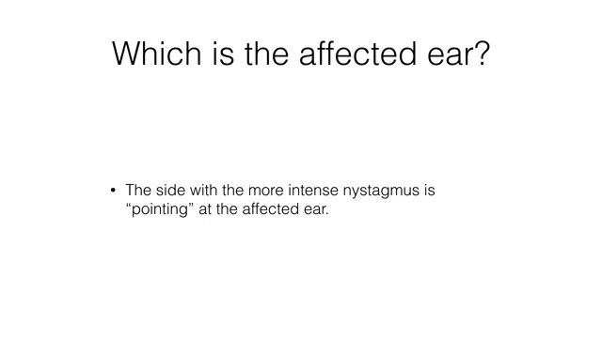

Slide 42
Dix Hallpike Knowledge Question
You are seeing a patient who reports 30-second attacks of intense dizziness triggered by turning over in bed that subside when lying still. You perform a Left Ear Dix Hallpike and see subtle horizontal, left beating nystagmus lasting 10 seconds and the patient feels a little dizzy. What is your next best step?
a) Proceed with Left Ear Epley to treat left ear BPPV
b) Perform a Supine Roll Test
c) Proceed with Right Ear Epley
d) Perform the Gufoni Maneuver
… horizontal nystagmus suggests horizontal canal BPPV, which is tested for with supine roll test
+ve Dix Hallpike = upward, torsional nystagmus

Slide 43
HINTS Exam Knowledge Question
You are seeing a patient with acute vestibular syndrome, continuous for 3 hours now. Negative for central features and you suspect vestibular neuritis. The patient has right beating horizontal nystagmus present in primary gaze, which gets more intense when the patient looks to the right. If the patient has vestibular neuritis, what will you see when you perform a head impulse test?
Catch up saccade when head is moved quickly to the right only
Catch up saccade when the head is moved quickly to the left only
Catch up saccade when head is moved quickly in either direction
No catch up saccade with quick head movements in either direction

Slide 44
Intro to HINTS+
You are seeing a 60y/o M - 3h ago was at home eating breakfast and had progressive onset over 5 minutes of continuous dizziness, nausea, imbalance, with 2 episodes of vomiting. The symptoms have been constant over 3h. He is lying still on the stretcher with eyes closed, and when he opens his eyes you notice nystagmus.
What Syndrome does he have?
Negative for central features on history and screening neuro exam.
What could be the cause of his ongoing vertigo+nystagmus? What is the next step?

Slide 45
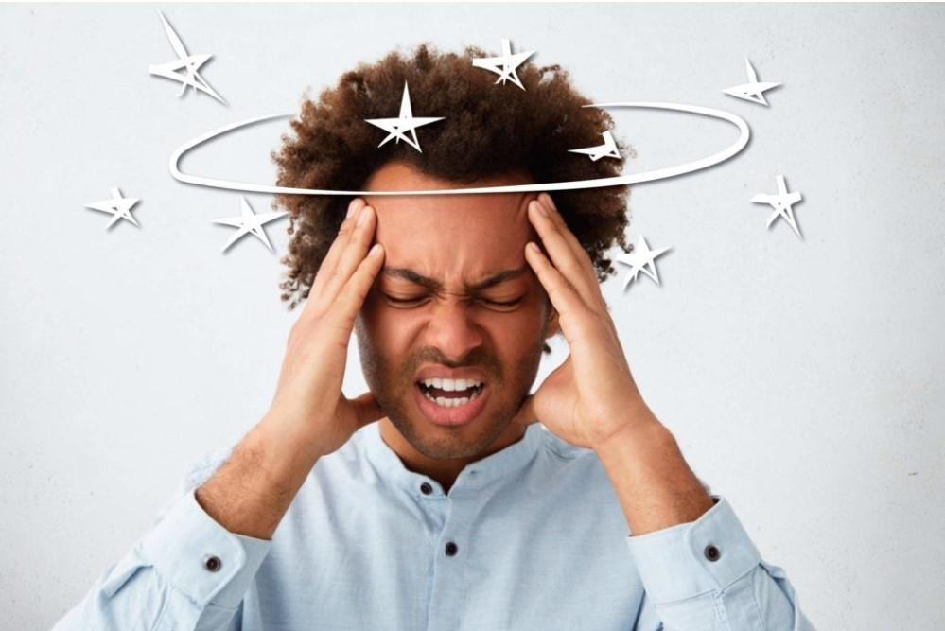
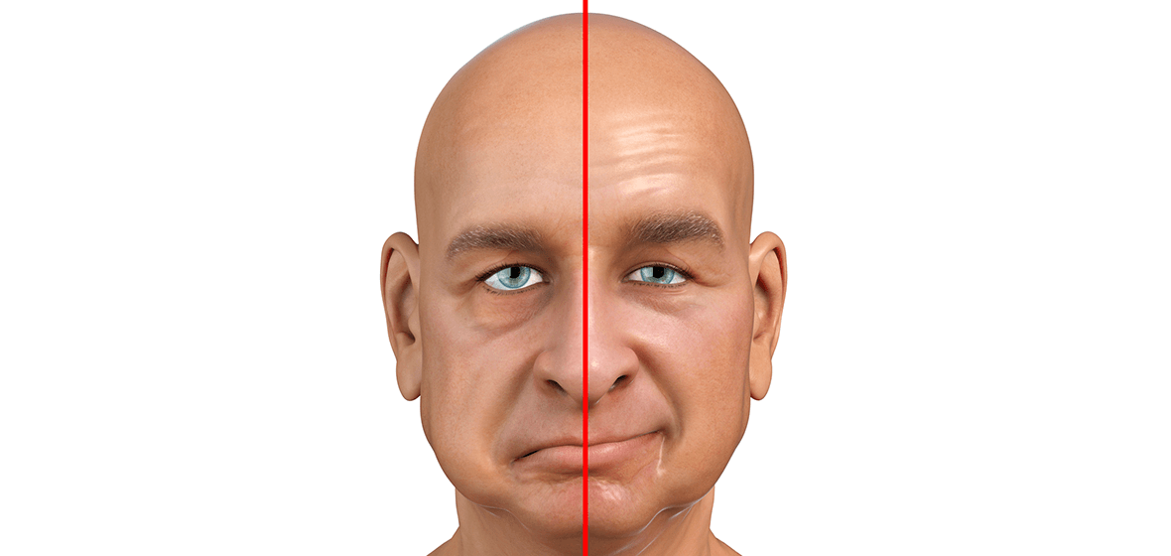
Simplified Analogy
Any patient with acute unilateral face droop
Your main job is to determine if they are having Bell’s Palsy (nerve problem) or a stroke (brain problem)
Any patient with acute vestibular syndrome
→ Your main job is to determine if they are having Vestibular Neuritis (nerve problem) or a stroke (brain problem)

Slide 46
HINTS+ exam
Key question: in a patient with AVS, are there any physical exam findings / bedside tests that can accurately differentiate peripheral from central cause?
HINTS = clinically validated, battery of 3 physical exam findings that accurately differentiate vestibular neuritis vs central lesion (mostly stroke) in patients who have acute vestibular syndrome with nystagmus
Plus a bedside test of hearing (finger rub)
In patients with AVS with nystagmus; Central (as opposed to peripheral) HINTS+ exam had sensitivity 99.0 specificity 84.8 for central cause
Most recent meta-analysis: HINTS+ LR(-) is 0.11
Shah et al 2023, Anburajan et al 2026

Slide 47
N->TS->HI
(save head impulse for last)
A central finding on any one of these tests means the overall HINTS exam is central

Slide 48
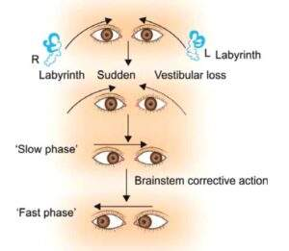
N = Typical Nystagmus in Vestibular Neuritis (VN)
WHAT IT IS
Unidirectional, horizontal, beating away from the affected ear
More pronounced when patient gazes in the direction of the nystagmus
Fades as symptoms improve, sometimes subtle (best seen on day 0-1 of symptoms)
Decreased by visual fixation
^if you’re thinking VN, the nystagmus should look like this
WHAT IT ISN’T
Direction changing with gaze
Vertical
^If you see either of these, you’re probably dealing with a stroke

Slide 49
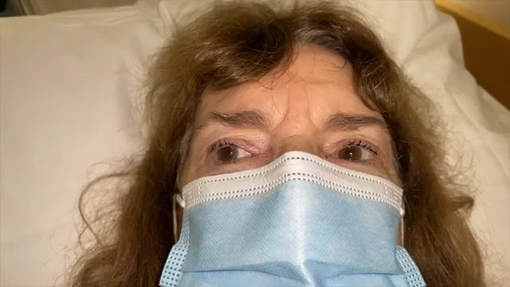
Nystagmus of VN -unidirectional, increases w gaze in direction of nystagmus

Slide 50
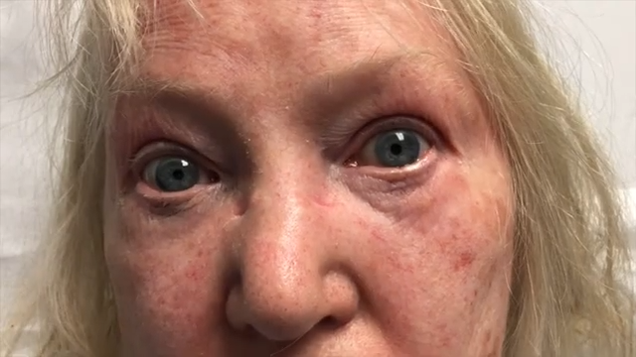
DIRECTION CHANGING NYSTAGMUS – Cannot be VN

Slide 51
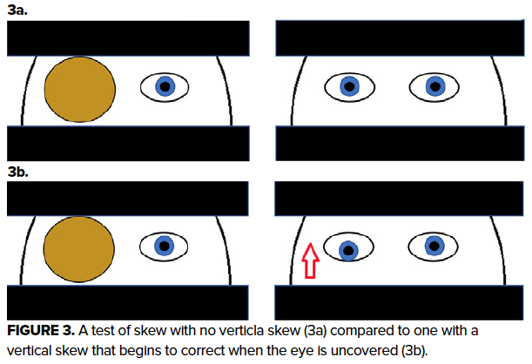
T = Test of Skew
Skew Deviation = vertical/diagonal misalignment of the eyes attributable to a central lesion
Alternate from L eye covered to R eye covered. At no time should both eyes be uncovered.

Slide 52
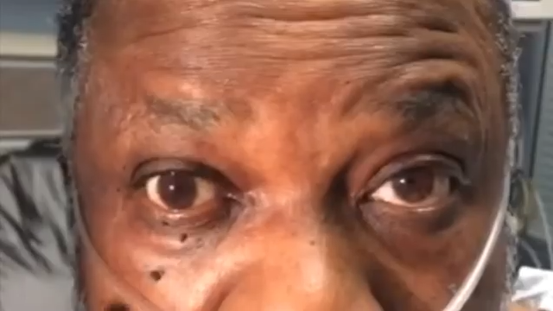
Vertical/Diagonal Skew Deviation – NEVER VN

Slide 53
HI = Head Impulse Test for Vestibulo-Ocular Reflex
Vestibulo-ocular reflex (VOR) = continuous vestibular input to eye muscles, causes eyes to automatically adjust to head movements
Patients with VN must, by definition, have an impaired VOR on the affected side
We can demonstrate impaired VOR with the with head impulse test

Slide 54
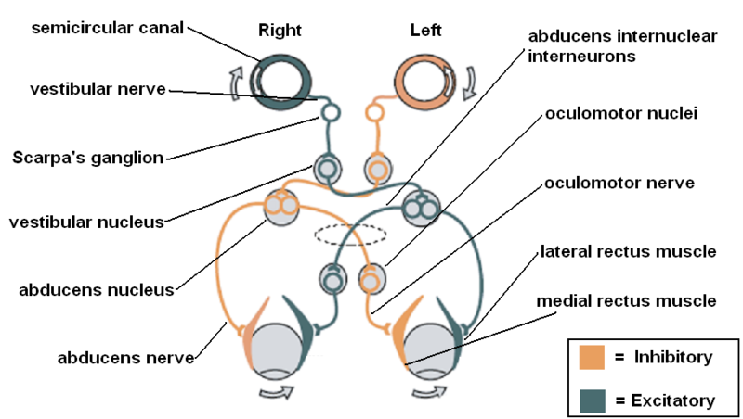

Slide 55
How to Perform a Head Impulse Test
Explain exam to patient, ask them to keep their eyes on your nose
Hold their skull with your hands
Move their head slowly back and forth 30 degrees left and right
Perform sudden rapid head movements back to midline while observing their eyes
In VN, catch up saccade should occur when only when head is moved quickly towards the affected ear

Slide 56
Counterintuitive
Abnormal Head Impulse Test => reassuring (it will be abnormal if they are having vestibular neuritis)
Normal Head Impulse Test => worrisome (it means they can’t be having vestibular neuritis so they’re probably having a stroke)
*Note: Since VN causes unilateral vestibular nerve dysfunction,
HIT should only be abnormal in one direction (towards affected ear)
Notes:
VN IS UNILATERAL – CATCH UP SACCADE ONLY OCCURS IN ONE DIRECTION

Slide 57
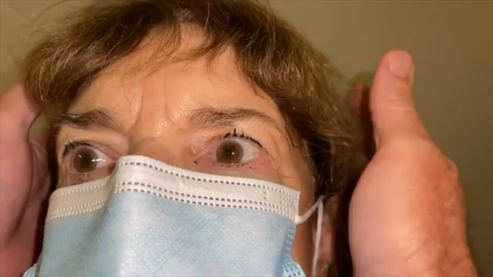

Slide 58
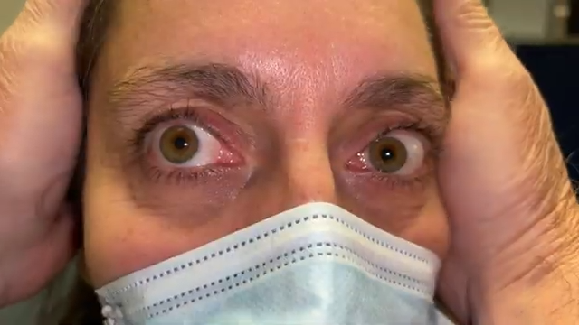

Slide 59
HINTS Exam Knowledge Question
You are seeing a patient with acute vestibular syndrome, continuous for 3 hours now. Negative for central features and you suspect vestibular neuritis. The patient has right beating horizontal nystagmus present in primary gaze, which gets more intense when the patient looks to the right. If the patient has vestibular neuritis, what will you see when you perform a head impulse test?
Catch up saccade when head is moved quickly to the right only
Catch up saccade when the head is moved quickly to the left only
Catch up saccade when head is moved quickly in either direction
No catch up saccade with quick head movements in either direction
Left ear VN produces R beating nystagmus and an abnormal L HIT

Slide 60
What if my dizzy patient has no nystagmus?
Vestibular neuritis CAUSES nystagmus (at least in the first couple days)
HINTS exam will only be peripheral if the patient actually has vestibular neuritis, all other patients will test central regardless of etiology
Patients who are “dizzy” without nystagmus could have many things wrong with them (including BPPV, vestibular migraine, dehydration, hypoglycemia, anemia, arrythmia, orthostatic hypotension, MI, anxiety, hyponatremia, sepsis etc etc)
–> HIT will falsely suggest stroke in all these patients
But “dizzy” patients without nystagmus could be having a STROKE
–> HIT not helpful here as it doesn’t differentiate stroke vs non-stroke Ddx
Be vigilant for central features – especially new objective difficulty walking

Slide 61
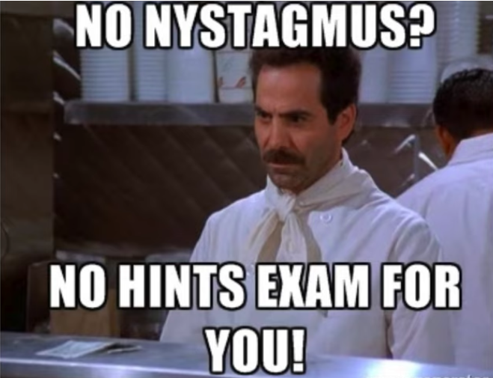

Slide 62
Diagnosis and Management of VN
Your documented history and exam findings must be consistent with your diagnosis (eg L VN produces R beating unidirectional nystagmus and abnormal L HIT)
Central screen negative, HINTS+ peripheral -> if they can ambulate they can be safely discharged
Counsel on diagnosis and expected trajectory -> 1st few days are worst, gradual improvement over days-weeks
Vestibular Rehabilitation IS helpful
Steroids and antivirals not well-supported by evidence
Dimenhydrinate PRN for nausea for maximum 3 days
Clear return to ED instructions

Slide 63
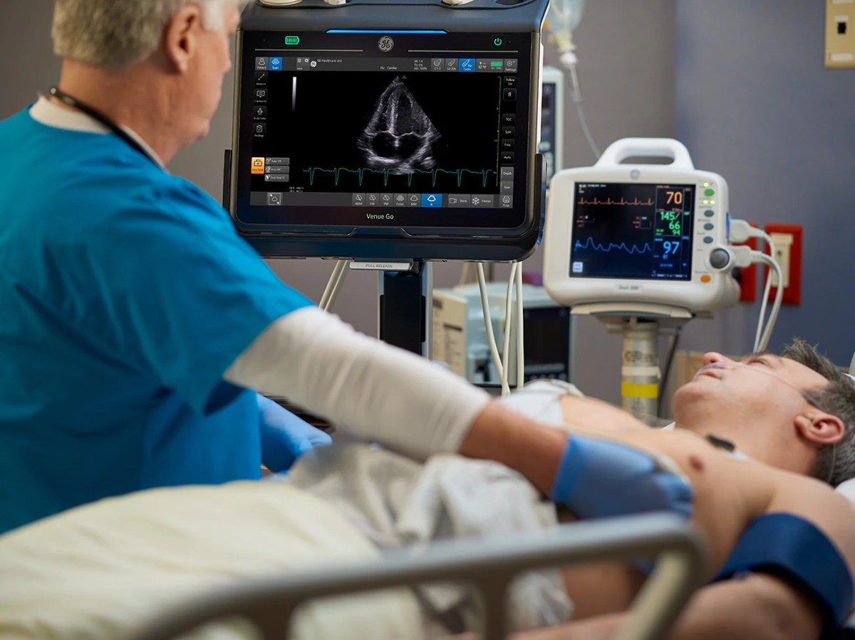
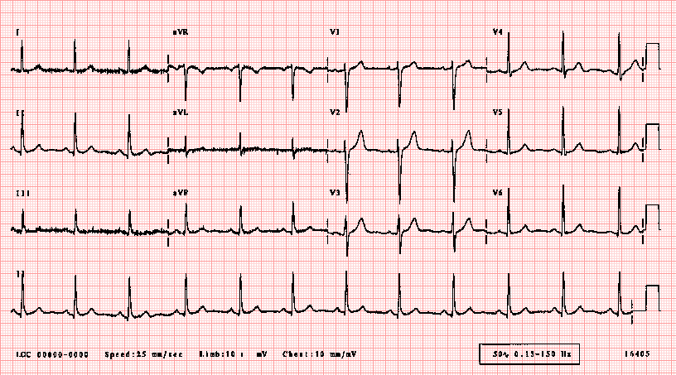
Can Non-Specialists Use the HINTS Exam?

Slide 64
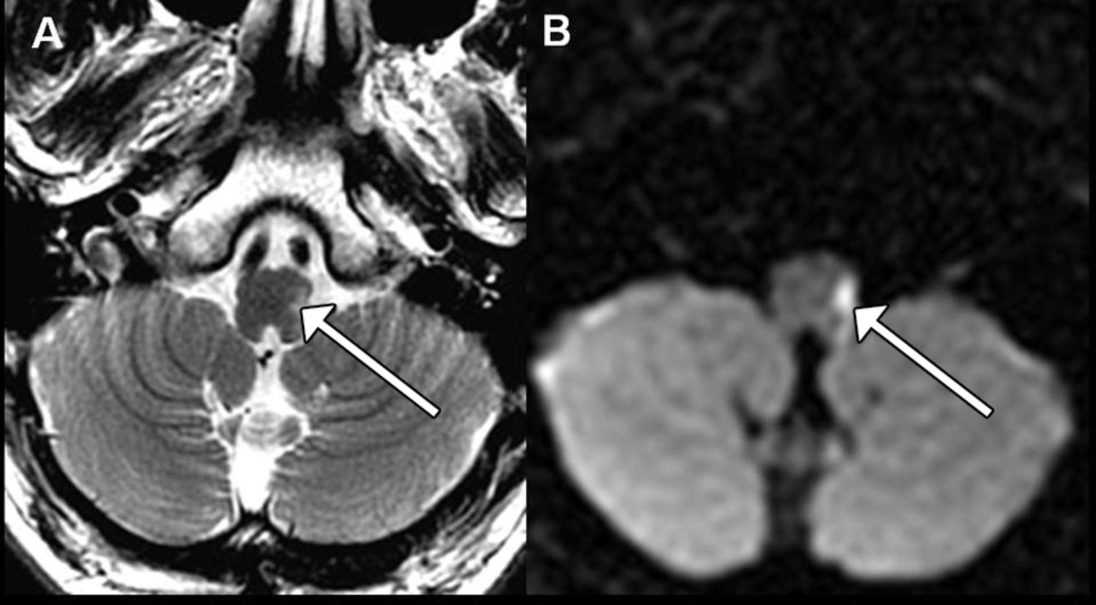
Myth - Normal CT Means My Dizzy Patient Is Not Having A Stroke
CT Sensitivity
CTA Sensitivity
MRI Sensitivity
HINTS+ Sensitivity
28.5 %
14.3 %
79.8 %
99.0%
(delayed MR after ~48 hours is more sensitive than early MR)
Shah et al 2023

Slide 65
Putting it all together

Slide 66
Patient with acute dizziness/vertigo: Simplified Approach
Central Features Present?
New headache/neck pain, focal neuro symptoms, Dangerous D’s, vertical nystagmus at rest, new inability to stand/walk unaided
Must workup for stroke, CONSIDER
- CT/CTA to r/o bleed/dissection
Admission for observation + MRI
Antiplatelet
Consult Neuro
Local hyperacute / “Code Stroke” protocol if new profound/disabling deficits<24h
Central Features Absent?
Always consider general medical causes + postural hypotension
HINTS+ central
<2min attacks of dizziness triggered by head movements: provocative testing for BPPV, particle repositioning maneuver if positive
Spontaneous, continuous dizziness+N/V+nystagmus lasting hours to days: HINTS+ peripheral and can ambulate – dx with VN and dispo home

Slide 67
Big 3 + 1 = Vestibular Migraine
Common
Recurrent (>=5), transient episodes of vertigo lasting minutes-days
Episodes often have migraine features (eg progressive onset over 30 minutes-hours, photophobia, phonophobia, activity avoidance, visual symptoms)
Episodes often associated with headache
In a patient with history of migraine-type headaches

Slide 68
Helpful Educational Resources
Peter Johns’ Youtube Channel
Spin Class – online CME course by Peter Johns + Scott Weingart
VertiGuide – smartphone app hosted by Johns Hopkins based on GRACE-3 guidelines

Slide 69
References
Anburajan, G., Kattah, J., Wang, Z. et al. HINTS+ to diagnose AICA stroke: systematic review of the diagnostic impact of acute unilateral hearing loss in the acute vestibular syndrome. J Neurol 273, 131 (2026). https://doi-org.libaccess.lib.mcmaster.ca/10.1007/s00415-026-13641-3
Giommetti G, Lapenna R, Panichi R, Mobaraki PD, Longari F, Ricci G, Faralli M. Residual dizziness after successful repositioning maneuver for idiopathic benign paroxysmal positional vertigo: a review. Audiology research. 2017 May 9;7(1):178.
Kerber KA, Newman-Toker DE. Misdiagnosing the dizzy patient: common pitfalls in clinical practice. Neurologic clinics. 2015 Aug;33(3):565.
Lindell E, Finizia C, Johansson M, Karlsson T, Nilson J, Magnusson M. Asking about dizziness when turning in bed predicts examination findings for benign paroxysmal positional vertigo. Journal of Vestibular Research. 2018 Nov 29;28(3-4):339-47.
Newman-Toker DE, Cannon LM, Stofferahn ME, Rothman RE, Hsieh YH, Zee DS. Imprecision in patient reports of dizziness symptom quality: a cross-sectional study conducted in an acute care setting. InMayo Clinic Proceedings 2007 Nov 1 (Vol. 82, No. 11, pp. 1329-1340). Elsevier.
Shah VP, Oliveira J. e Silva L, Farah W, Seisa MO, Balla AK, Christensen A, Farah M, Hasan B, Bellolio F, Murad MH. Diagnostic accuracy of the physical examination in emergency department patients with acute vertigo or dizziness: a systematic review and meta‐analysis for GRACE‐3. Academic Emergency Medicine. 2023 May;30(5):552-78.
Shah VP, Oliveira J. e Silva L, Farah W, Seisa M, Kara Balla A, Christensen A, Farah M, Hasan B, Bellolio F, Murad MH. Diagnostic accuracy of neuroimaging in emergency department patients with acute vertigo or dizziness: a systematic review and meta‐analysis for the guidelines for reasonable and appropriate care in the emergency department. Academic Emergency Medicine. 2023 May;30(5):517-30.
van Patot ET, Roy D, Baraku E, Patel K, McIsaac S, Singh R, Lelli D, Tse D, Johns P, Yadav K, Savage DW, Perry JJ, Ohle R. Validation of the Sudbury Vertigo Risk Score to risk stratify for a serious cause of vertigo. Acad Emerg Med. 2025 Aug;32(8):863-873. doi: 10.1111/acem.70017. Epub 2025 Mar 11. PMID: 40070159; PMCID: PMC12352473.

Slide 70
A few other considerations

Slide 71
BPPV on History but Positional Testing Negative?
Eg, You are seeing a 60F patient who reported sudden onset intense vertigo lasting 1 minute after turning over in bed. It settled when she lay still but then she had 4x similar episodes every time she repositioned or tried to get up out of bed, so she called EMS. She vomited once. Last episode was 3h ago now, in ED she feels milder residual dizziness and nausea but nothing like the episodes at home.
Screens -ve for central features. Dix Hallpike is -ve. Supine roll test is -ve.
→BPPV is a self-limiting condition that eventually resolves without treatment.
No red flags for central dizziness, and history consistent with BPPV – you can discharge with a diagnosis of resolved BPPV and good followup instructions
Ask patient “go ahead and do something you think will make you dizzy” prior to dc

Slide 72
What About Transient Dizziness? Could it be TIA?
Dizzy TIA mimics = common, dizzy TIA = uncommon
Always consider TIA mimics, eg postural hypotension, BPPV, vestibular migraine, Meniere’s, post concussion syndrome, cardiac syncope…
Transient dizziness with other central features –> workup and manage as TIA
Not consistent with TIA mimic, AND patient has stroke risk factors –> workup and manage as possible TIA
If not an obvious TIA mimic but low risk for stroke, consider local practice patterns

Slide 73
What about Labyrinthitis?
Some debate around the nomenclature
Generally accepted that VN causes pure vertigo while labyrinthitis causes vertigo PLUS additional inner ear symptoms (ie vertigo + tinnitus/hearing loss)
SSNHL may present as labyrinthitis (hearing loss, vertigo, tinnitus)
SSNHL often idiopathic, but could be caused by AICA stroke (so new hearing loss is a central finding in HINTS+)
If concern for SSNHL = contact ENT emergently and start prednisone 60mg PO daily
  Pt will likely require MR to ro AICA stroke or other lesion – depending on overall presentation, will need to decide if admission for MR/stroke pathway vs outpatient ENT/audiology pathway
Hum test is helpful to differentiate conductive vs sensorineural

Slide 74
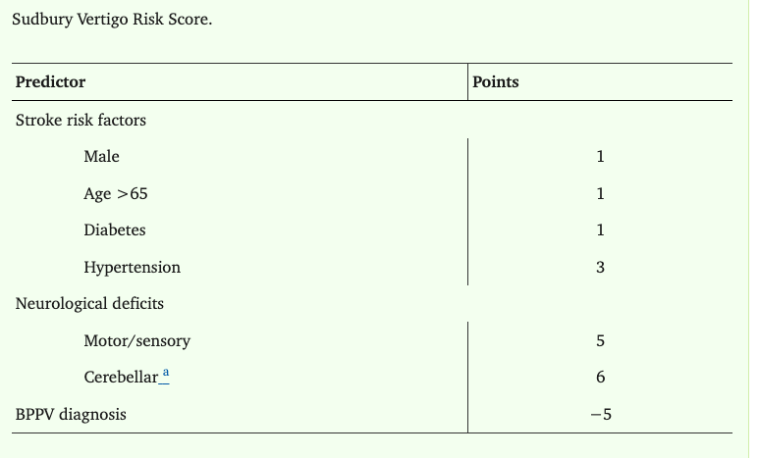
Sudbury Vertigo Score
Prospective Cohort, 3 academic centres
4559 ED patients w chief complaint of vertigo, dizziness, or imbalance
  2.3% had serious diagnosis
Low Risk: score <5 points - 0% risk of stroke
Mod risk: score 5-8 – 0.9% risk of stroke
High Risk score >8 – 16% risk of stroke
Problems: BPPV diagnosis+neuro deficits doesn’t make sense!
Could miss YOUNG patients with strokes if clinician thinks it’s BPPV or subtle neuro find
Could mislead for older patients with obvious BPPV who just need epley/gufoni

Slide 75
Appendix/Extras

Slide 76
Dix Hallpike video
https://www.youtube.com/watch?v=7ePecb9azS4

Slide 77
Epley Maneuver Video
https://youtu.be/kvVnEsGVLUY?si=XcO8sliRAL1yRuG4&t=120

Slide 78
Supine Roll Video
https://youtu.be/VRjRTnIw9YE?si=geK5KKaGFfZgemue&t=231

Slide 79
HINTS exam video
https://youtu.be/-VXwD2nskhQ?si=-h16dXI5CJIftcqW&t=161
https://youtu.be/lkjWjFSVFGM?si=Ol8MmE5VhTtQOojt&t=340

Slide 80
End Gaze Nystagmus (normal variant)
https://www.youtube.com/watch?v=2Ej3jwgvwMU

